Slide 1

Statistical and machine learning models for resolving metabolomics spectra
Dr Vinny Davies, University of Glasgow
Joint work with Nikolaos Terzis, Andrew Elliott, Rónán Daly, Joe Wandy, Justin JJ van der Hooft

Slide 2

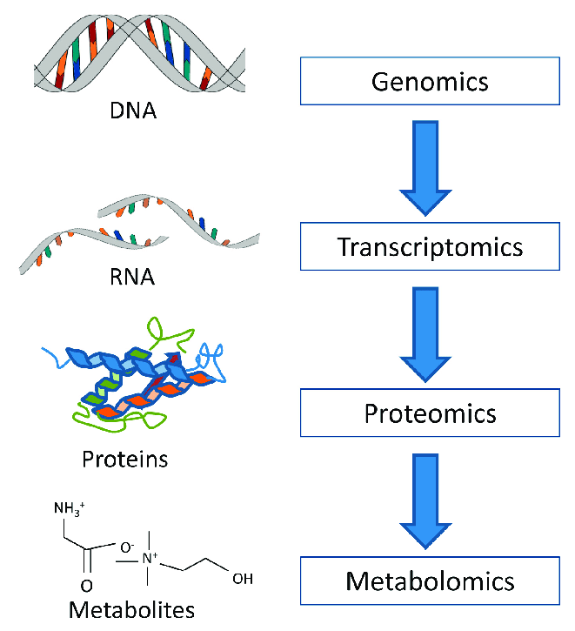
What is Metabolomics?
Metabolomics is the "systematic study of the unique chemical fingerprints that specific cellular processes leave behind", the study of their small-molecule metabolite profiles.
Basically, we are trying to identify all the metabolites in a particular sample

Slide 3
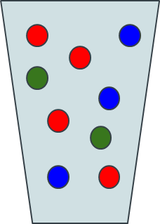
Metabolomics Workflow
Sample + Sample Preparation

Slide 4
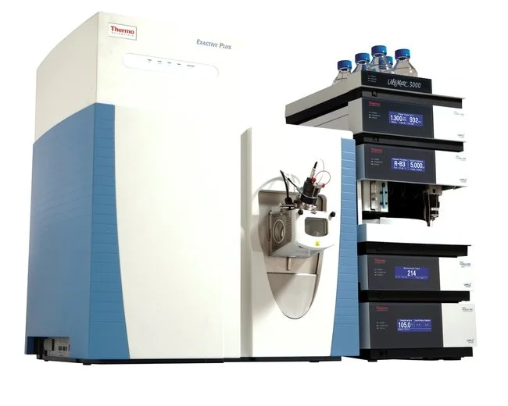
Metabolomics Workflow
Sample + Sample Preparation
Data Collection

Slide 5
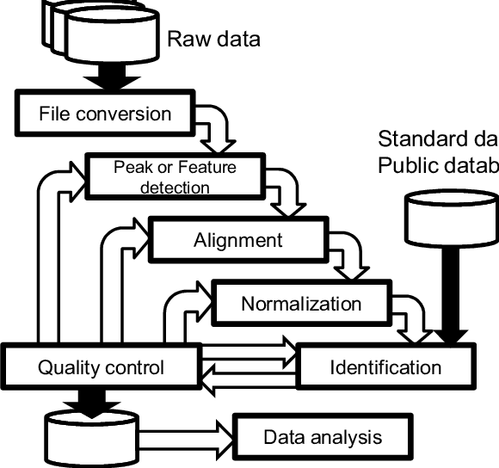
Metabolomics Workflow
Sample + Sample Preparation
Data Collection
Data Processing

Slide 6
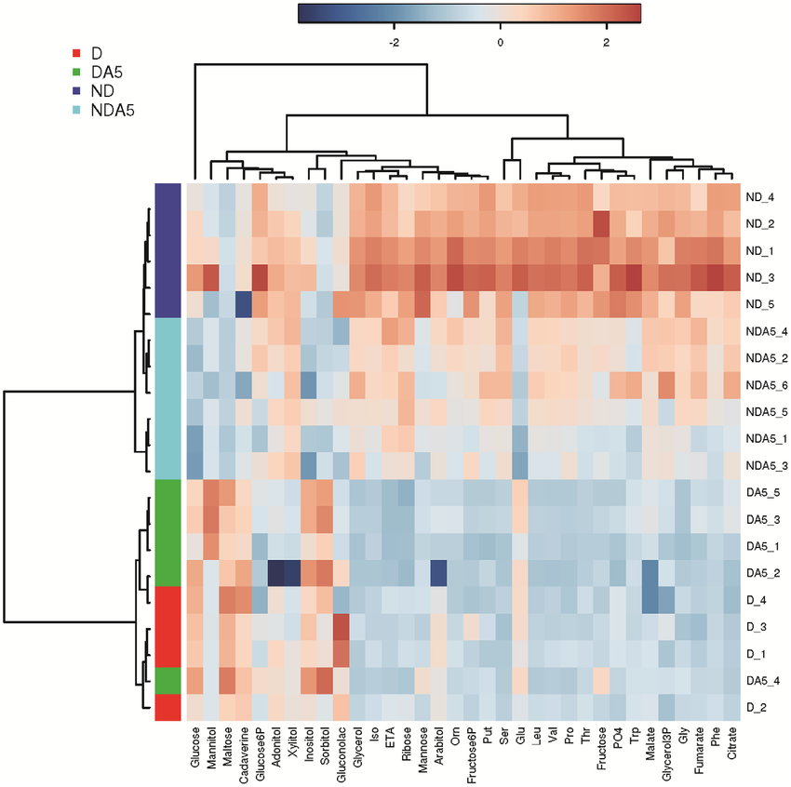
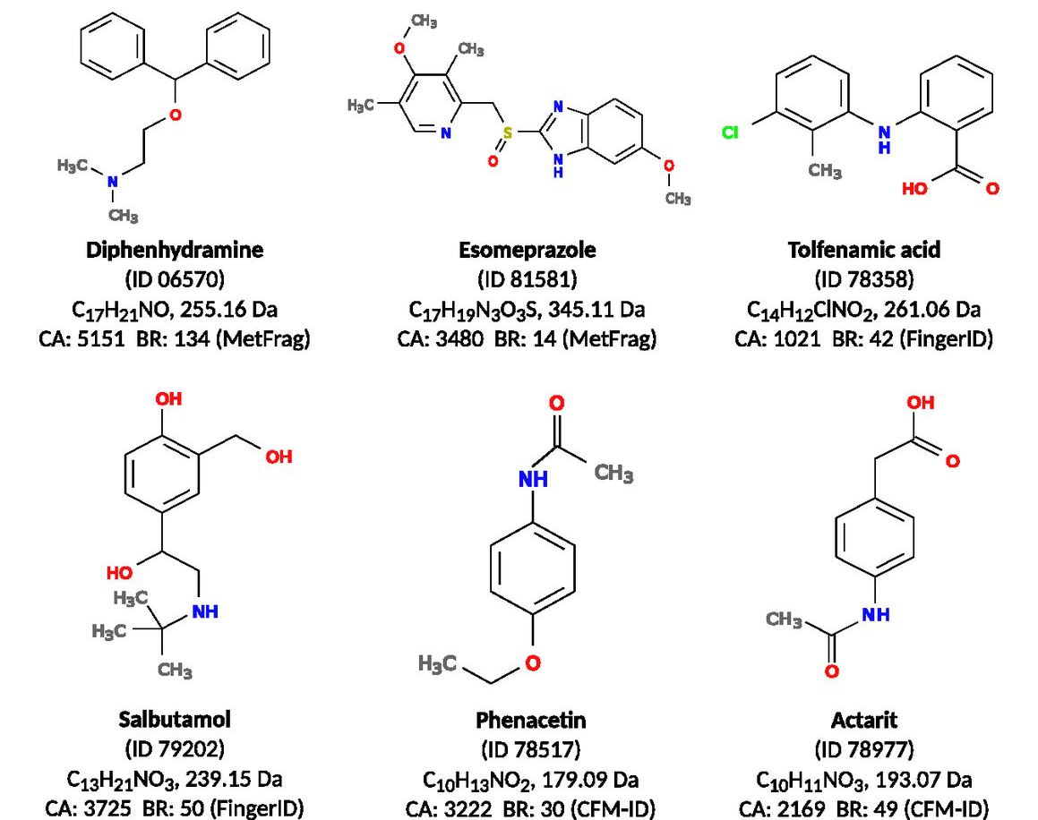
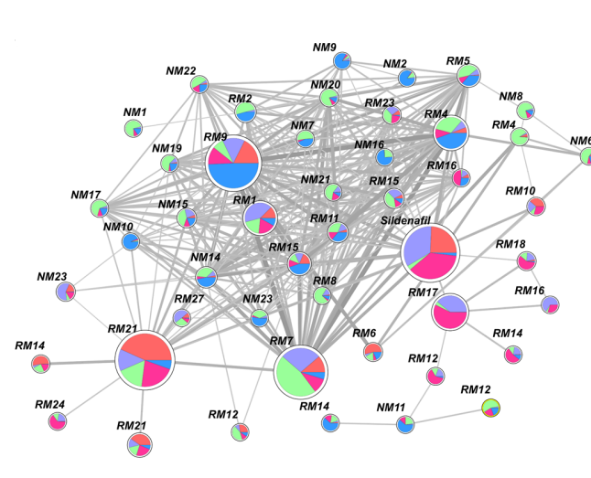
Statistical Analysis
Metabolomics Workflow
Sample + Sample Preparation
Data Collection
Data Processing
Metabolite Identification
Molecular Networking

Slide 7
Metabolomics Mass Spectrometry Experiments
Samples can be extremely varied, but standard option is blood, urine, etc – We use beer!
No data protection issues
Cheap and easily available
Similar enough for method development

Slide 8
Metabolomics Mass Spectrometry Experiments
Samples can be extremely varied, but standard option is blood, urine, etc – We use beer!
No data protection issues
Cheap and easily available
Similar enough for method development
Ionisation

Slide 9
Metabolomics Mass Spectrometry Experiments
Samples can be extremely varied, but standard option is blood, urine, etc – We use beer!
No data protection issues
Cheap and easily available
Similar enough for method development
Mass Spectrometer
Ionisation

Slide 10
Metabolomics Mass Spectrometry Experiments
Samples can be extremely varied, but standard option is blood, urine, etc – We use beer!
No data protection issues
Cheap and easily available
Similar enough for method development
Mass Spectrometer
Intensity
Ionisation
m/z

Slide 11
LC-MS/MS
MS
scans
Sample
Sample fraction, collected in small time period
Mass (per charge)
Chromatographic peaks
intensity
Chromatographic retention time
retention time

Slide 12
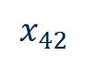
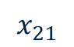
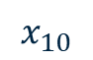
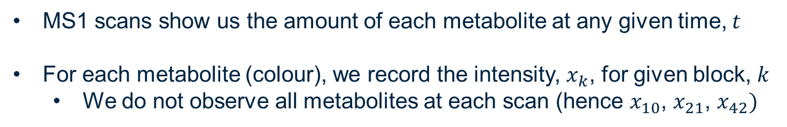
MS1 Scans
MS1 scans show us the amount of each metabolite at any given time, $t$
For each metabolite (colour), we record the intensity, $x_{k}$, for given block, $k$
We do not observe all metabolites at each scan (hence $x_{10}$, $x_{21}$, $x_{42})$
$$x_{10}$$
$$x_{21}$$
$$x_{42}$$
Intensity
m/z

Slide 13


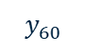
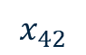
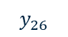
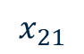
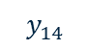
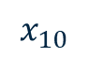
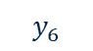
MS2 Scans
MS2 scans allow us to break down the metabolites, so that we can identify them – this can be done for single metabolites (DDA)
$$x_{10}$$
$$x_{21}$$
$$x_{42}$$
Intensity
Intensity
$$y_{14}$$
$$y_{6}$$
$$y_{26}$$
$$y_{60}$$
m/z
m/z

Slide 14
MS2 Scans
This becomes more difficult in our experiments where we do it for multiple metabolites (DIA)
$$x_{10}$$
$$x_{21}$$
$$x_{42}$$
Intensity
Intensity
m/z
m/z

Slide 15
MS2 Scans
This becomes more difficult in our experiments where we do it for multiple metabolites (DIA)
What we actually see (no colours)
$$x_{10}$$
$$x_{21}$$
$$x_{42}$$
Intensity
Intensity
m/z
m/z

Slide 16
Our Aim
Intensity
m/z
Intensity
Intensity
Intensity
m/z
m/z
m/z

Slide 17
How do we do this?
Link all our MS1 scans to all our MS2 scans
1000-2000 of each scan type
2000-5000 metabolite (each observed over 10-100 MS1/MS2 scans)
50,000-100,000 fragments (each observed over 10-100 MS2 scans
Intensity
Intensity
m/z
m/z

Slide 18
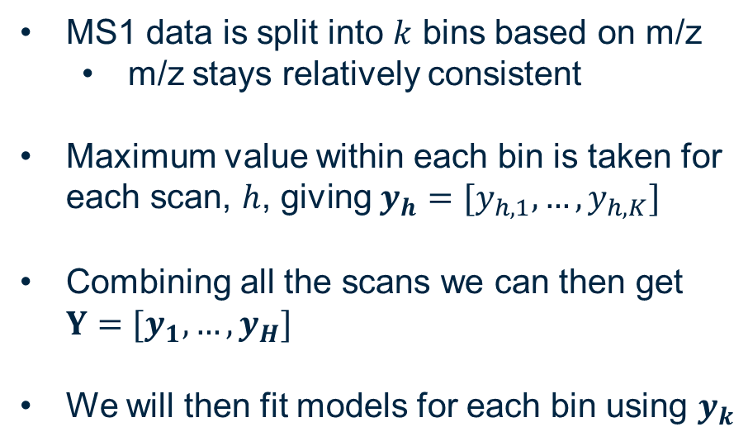
Data Format – Response
MS1 data is split into $k$ bins based on m/z
m/z stays relatively consistent
Maximum value within each bin is taken for each scan, $h$, giving $y_{h}=[y_{h,1},…,y_{h,K}]$
Combining all the scans we can then get $Y=[y_{1},…,y_{H}]$
We will then fit models for each bin using $y_{k}$
Intensity
m/z

Slide 19
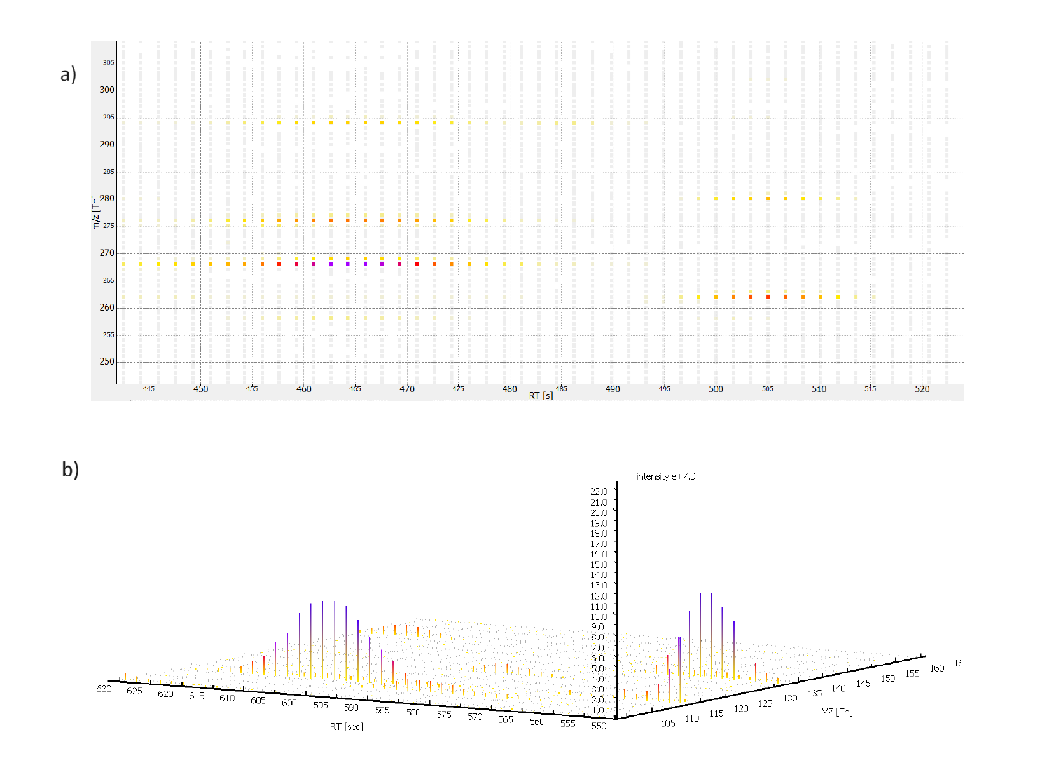
Data Format – Covariates
Peaks are identified using all the MS1 scans
Intensity
m/z

Slide 20
Data Format – Covariates
Peaks are identified using all the MS1 scans
Intensity
m/z

Slide 21
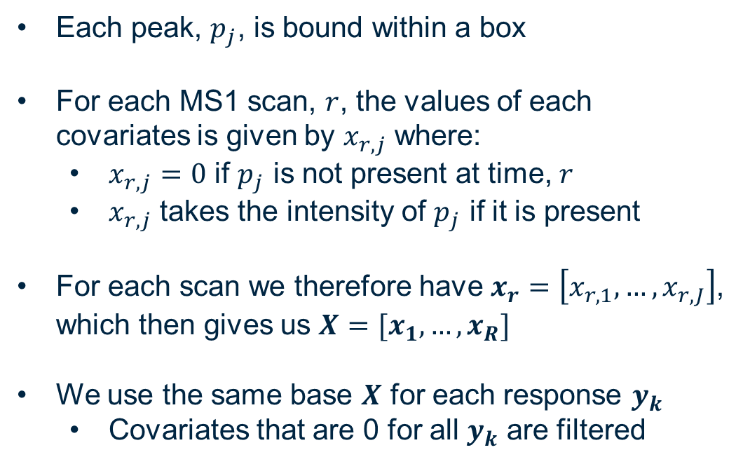
Data Format – Covariates
Each peak, $p_{j}$, is bound within a box
For each MS1 scan, $r$, the values of each covariates is given by $x_{r,j}$ where:
$x_{r,j}=0$ if $p_{j}$ is not present at time, $r$
$x_{r,j}$ takes the intensity of $p_{j}$ if it is present
For each scan we therefore have $x_{r}=\left[x_{r,1},…,x_{r,J}\right]$, which then gives us $X=[x_{1},…,x_{R}]$
We use the same base $X$ for each response $y_{k}$
Covariates that are 0 for all $y_{k}$ are filtered
Intensity
m/z

Slide 22
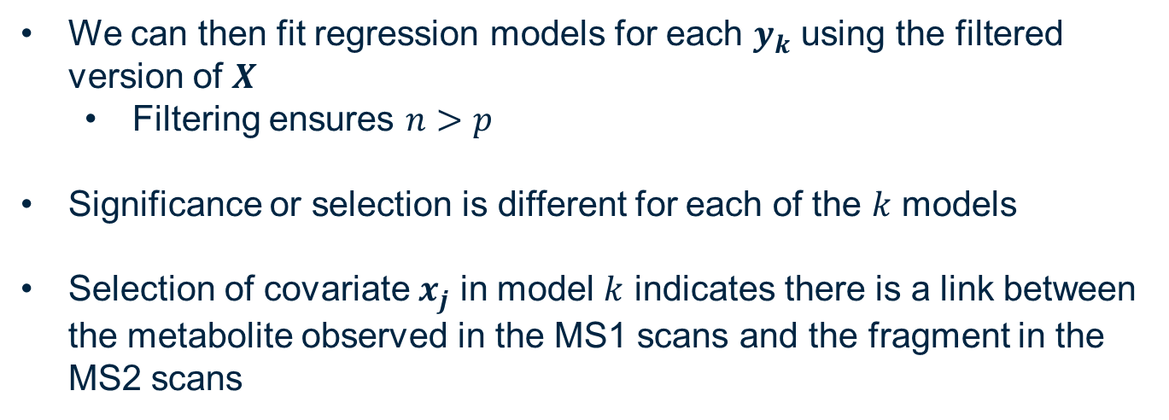
Regression Models
We can then fit regression models for each $y_{k}$ using the filtered version of $X$
Filtering ensures $n>p$
Significance or selection is different for each of the $k$ models
Selection of covariate $x_{j}$ in model $k$ indicates there is a link between the metabolite observed in the MS1 scans and the fragment in the MS2 scans

Slide 23
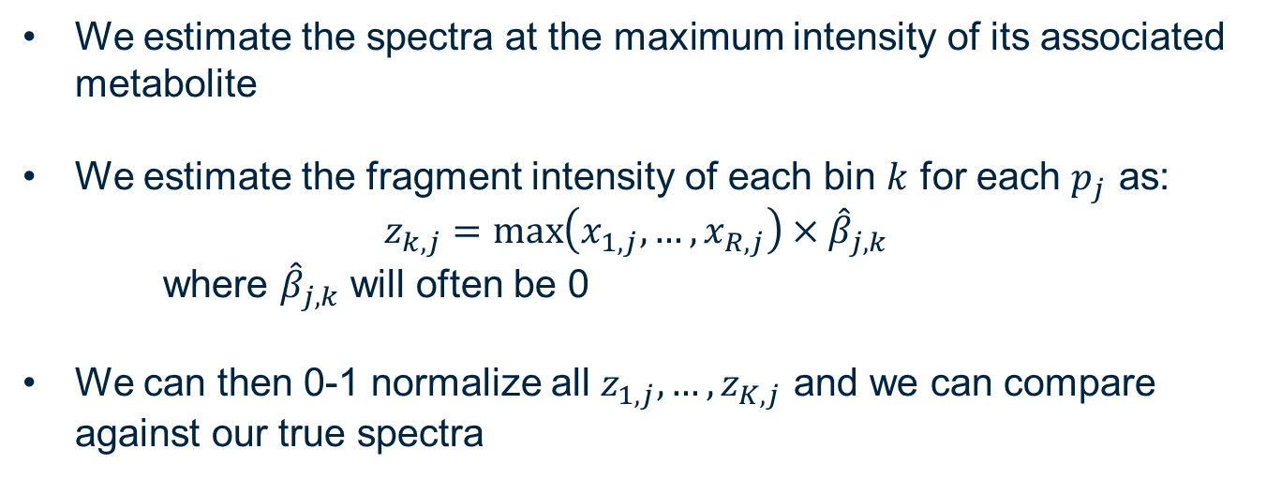
Reconstruction of Spectra
We estimate the spectra at the maximum intensity of its associated metabolite
We estimate the fragment intensity of each bin $k$ for each $p_{j}$ as:
$$z_{k,j}=\max\left({x_{1,j},…,x}_{R,j}\right)×{\hat{β}}_{j,k}$$
where ${\hat{β}}_{j,k}$ will often be 0
We can then 0-1 normalize all $z_{1,j},…,z_{K,j}$ and we can compare against our true spectra

Slide 24

Evaluation via a Digital Twin
We initially evaluated our method (MSDeconvolve) on our digital twin (simulator) called ViMMS
ViMMS can simulate full LC-MS/MS experiments and
ViMMS has been shown to be able to replicate existing methods

Slide 25
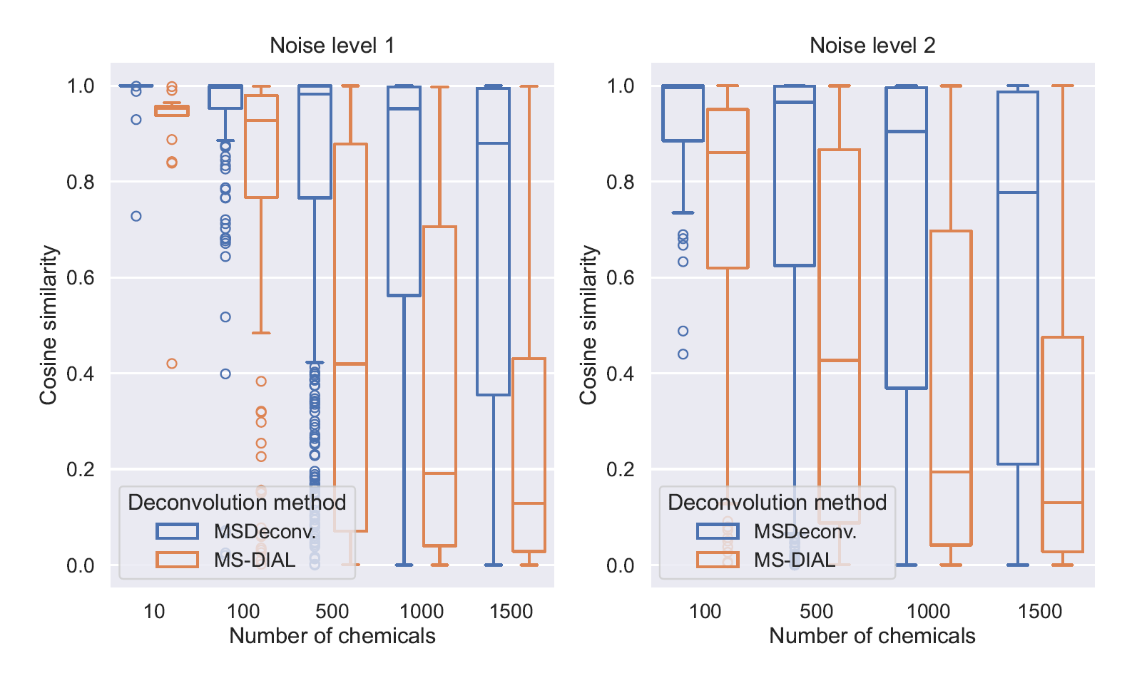
Evaluation via a Digital Twin
Results on the digital twin are extremely encouraging

Slide 26
Evaluation via real data
Current thoughts
“Maybe we should submit it to Nature rather than Nature Methods”
“We have tested ViMMS extensively and it's always been reliable, so surely it’ll be the same for this…”
Let’s see…

Slide 27
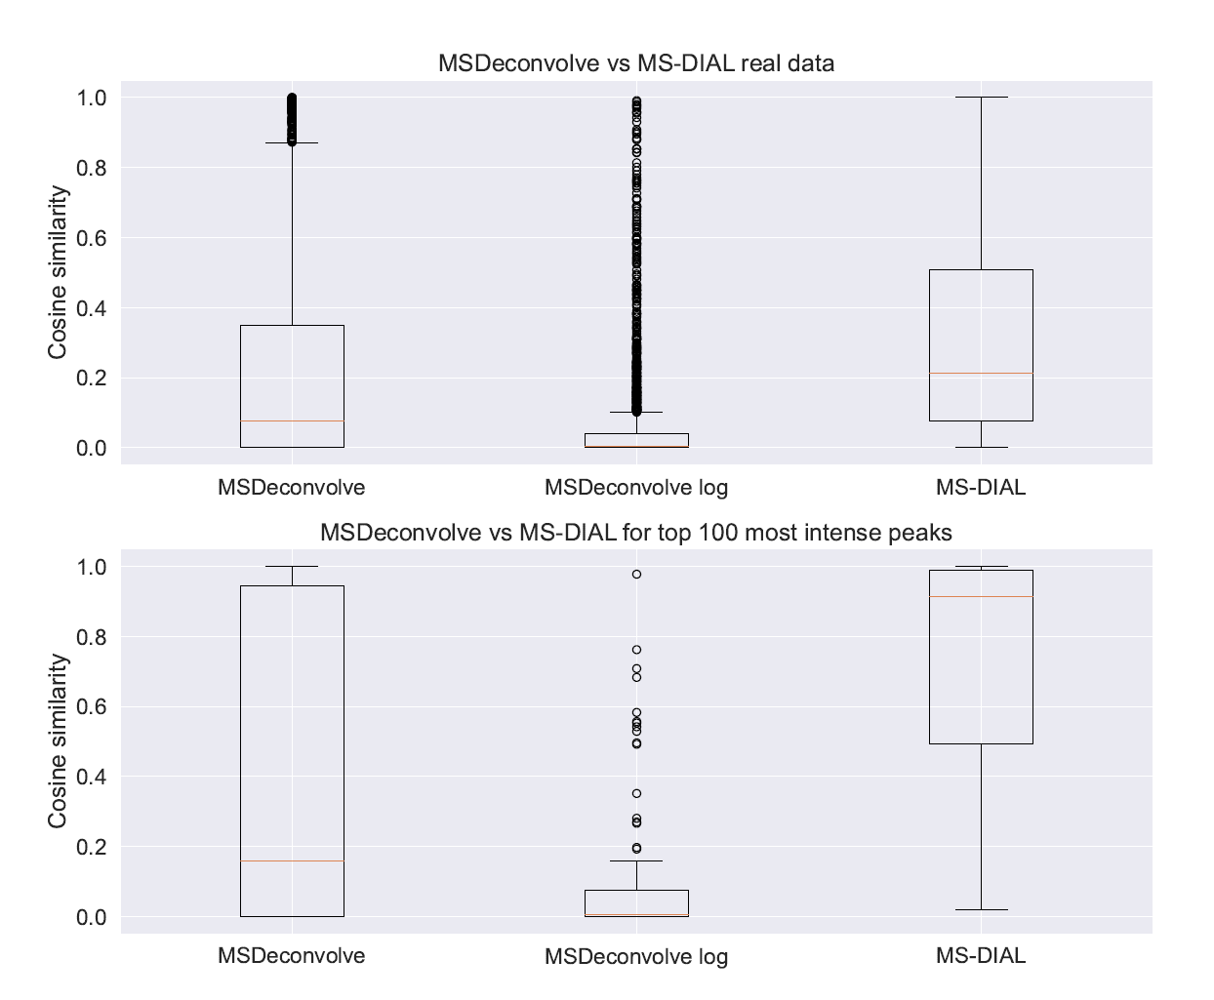
Evaluation via real data
Ah…

Slide 28
Evaluation via real data
Ah…
Maybe its still fixable?

Slide 29
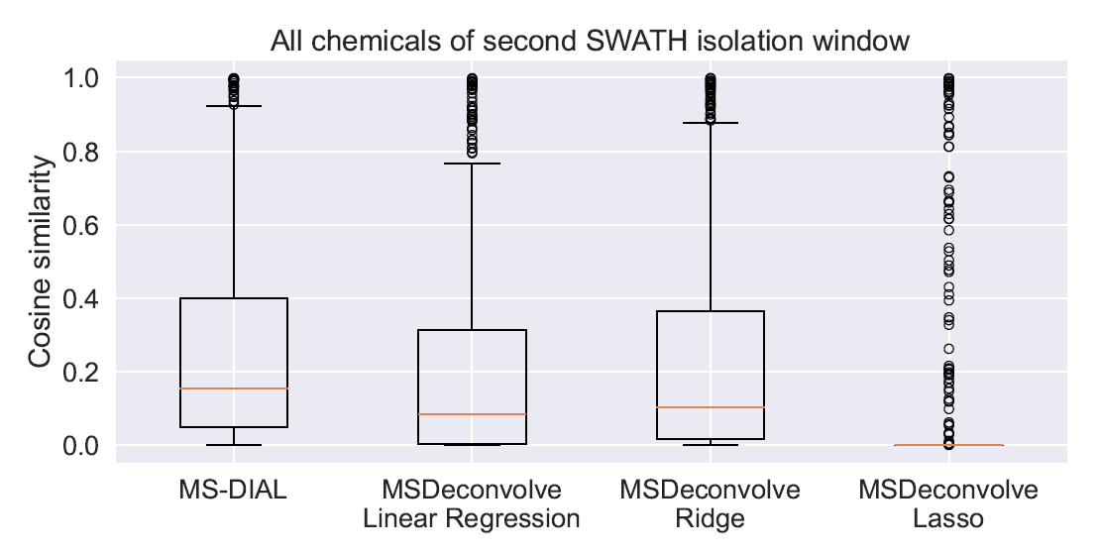
Comparison of Methods
We compared several readily available methods
Requires relatively fast methods, as need to fit around 1000 models and people would expect results in around 15mins

Slide 30
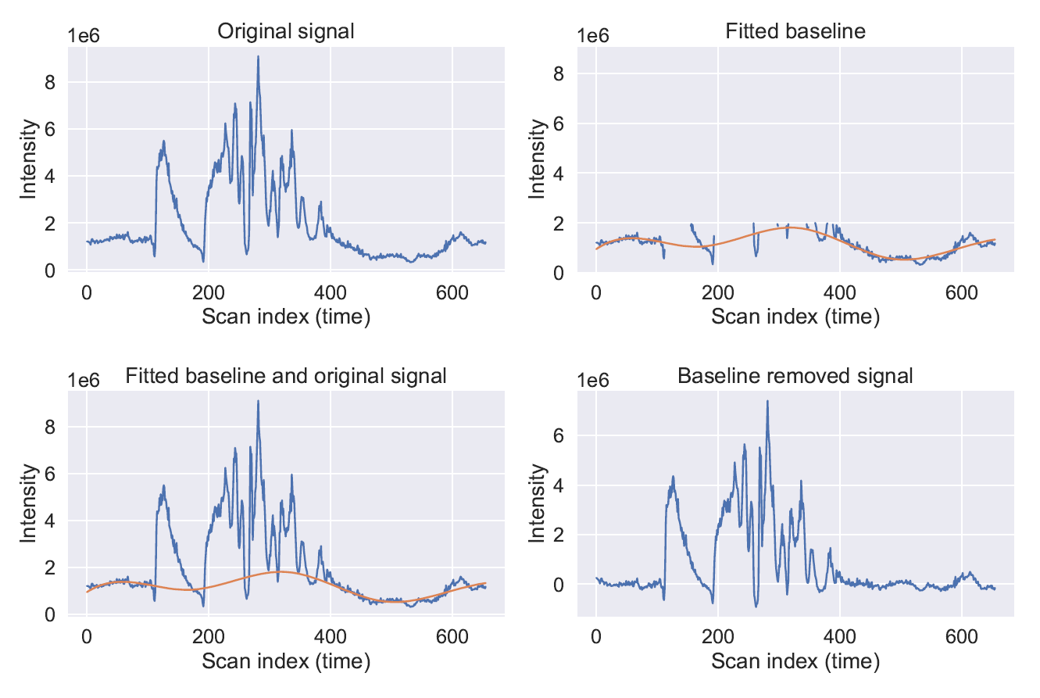
Baseline Noise Removal
We tried removing the baseline noise

Slide 31
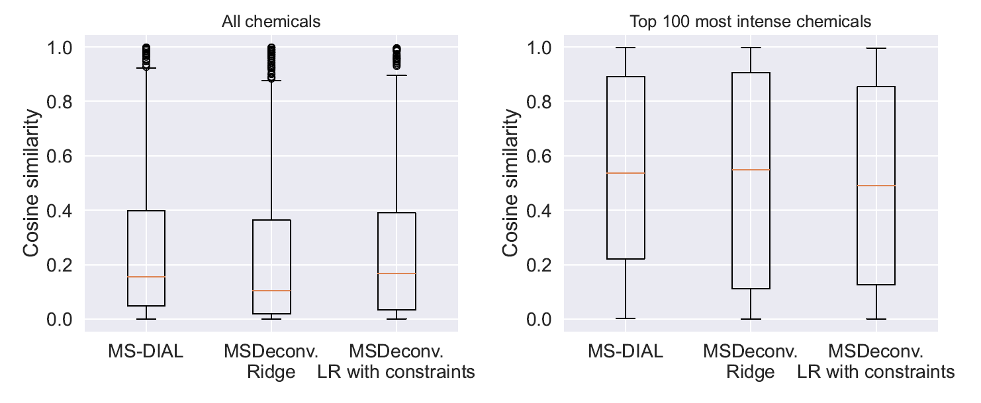
Constrained Covariates
Constraining the model coefficient to be positive gave a small increase in performance

Slide 32
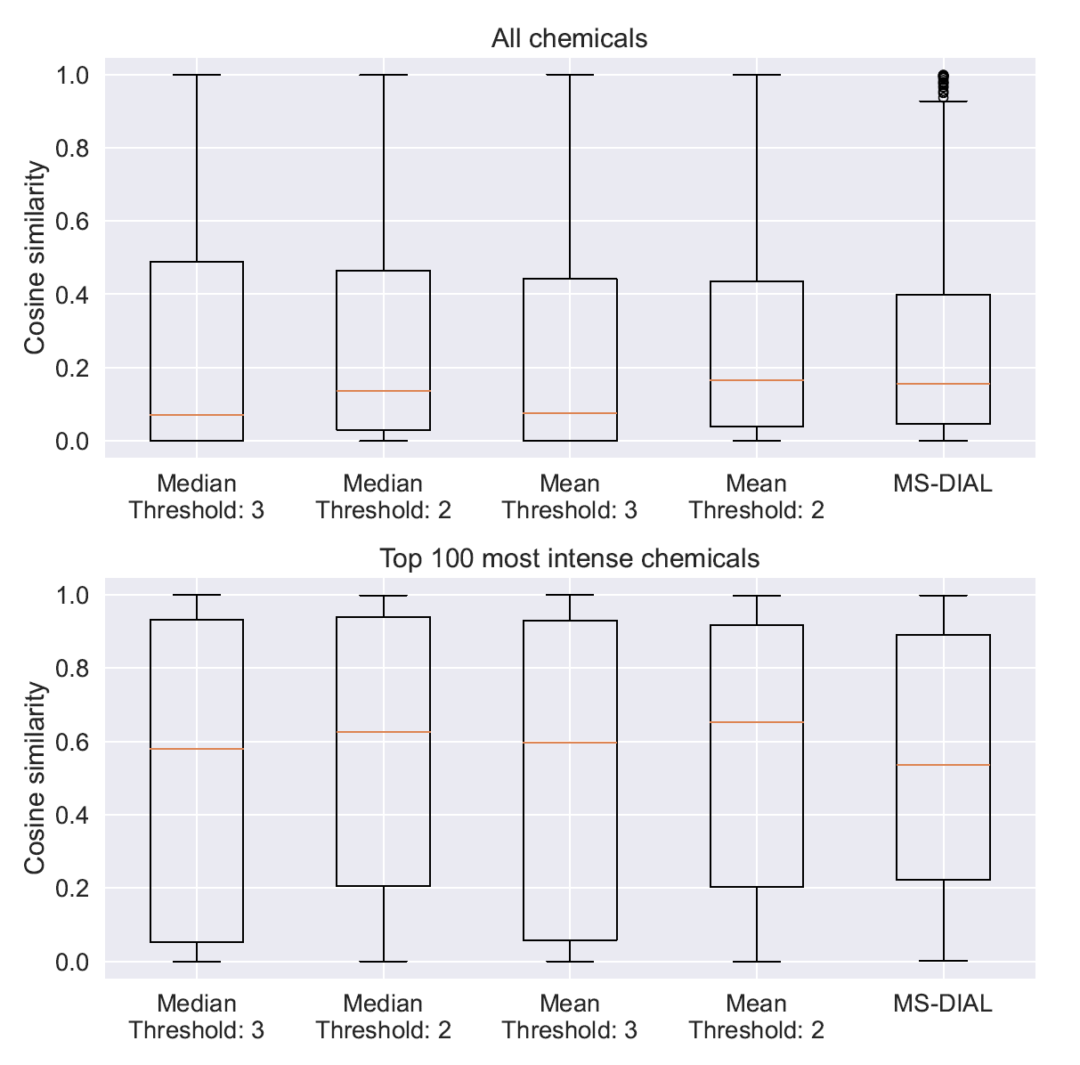
Ensemble Approach
Combining multiple versions of MSDeconvolve with MS-DIAL via an Ensemble approach gave a small improvement in performance
Different thresholds were used to compare the performance

Slide 33
Conclusions
The performance of MSDeconvolve is not particularly good
Its performance on the simulated data suggests that the concept makes sense, but more work is needed
Likely the noise and data complexity is overwhelming the model
Future Plans
Remove the dependence on peak picking
Add additional constraints based on prior knowledge

Slide 34

Thanks for Listening
Let me know if you have any questions
Or feel free to reach out at: Vinny.Davies@Glasgow.ac.uk
Slides available (soon) at:
https://github.com/vinnydavies/presentations

